Slide 1
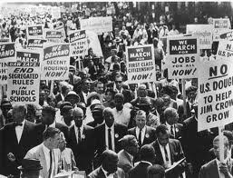
In the box:
Mass Mobilization and Movement Leadership
Abdul Alkalimat
University of Illinois

Slide 2
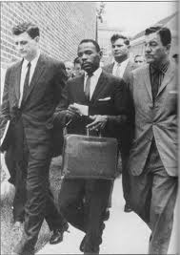
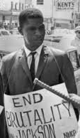
The 1960’s was a war against racist terror
during which non-violent protestors faced
murder, bombing, shooting, and lynching.
Federal Marshalls escort
James Meredith when he
integrates the University
of Mississippi (Oct 1962)
Mississippi NAACP
leader Medgar Evers
murdered (June 1963)

Slide 3
Critical High Points of the Civil Rights Movement
Year | Month | Place | Event | Total
1963 | August | Washington, D.C. | March on Washington | 250,000 people marched
1963 | October | Chicago | 1st School Boycott | 225,000 students boycotted school
1964 | February | Chicago | 2nd School Boycott | 172,350 students boycotted school
1964 | June | Mississippi | Mississippi Summer Project | 1,000 organizers go to Mississippi
1964 | August | Atlantic City | Mississippi Freedom Democratic Party | 64 delegates go to Democratic convention

Slide 4

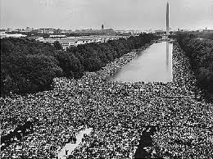
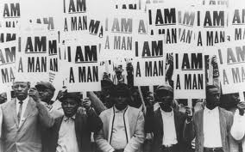
Critical Questions
What was the mobilization?
What led to the mobilization?
Who led the mobilization?
How was unity maintained in the movement?
What was the outcome?
What response came from the racists?

Slide 5
March
on
Washington

Slide 6
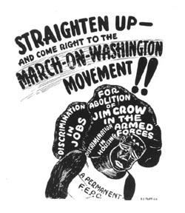
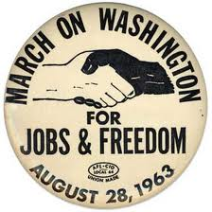
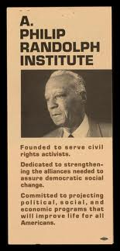
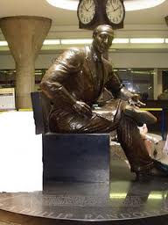
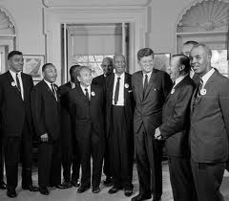
1941
Philip Randolph
(1889 – 1979)
Labor leader who
led the 1941 and
the 1963 marches
For jobs and
freedom

Slide 7
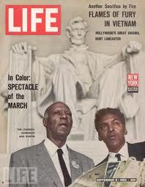
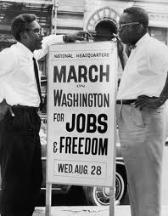
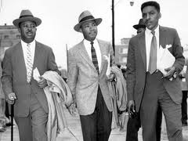
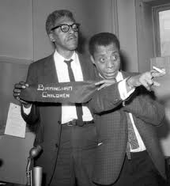
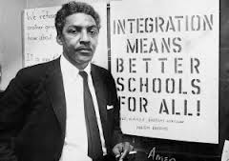

Slide 8
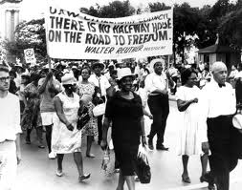
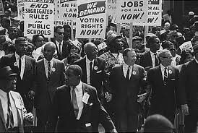
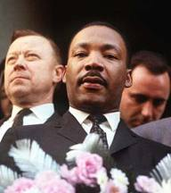
The March on Washington was
given strong organizational support
by the trade union movement,
especially the United Auto Workers
And their leader Walter Reuther.

Slide 9
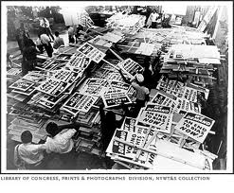
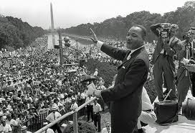
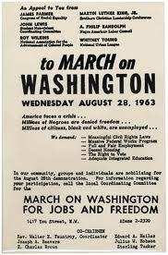
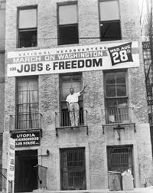
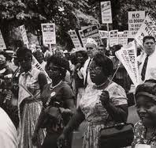

Slide 10
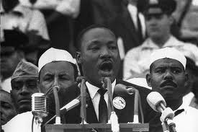
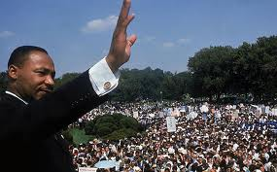
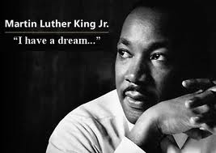
I have a dream that one day even the state of Mississippi, a state sweltering with the heat of injustice, sweltering with the heat of oppression, will be transformed into an oasis of freedom and justice.
I have a dream that my four little children will one day live in a nation where they will not be judged by the color of their skin but by the content of their character.
I have a dream today!
I have a dream that one day, down in Alabama, with its vicious racists, with its governor having his lips dripping with the words of "interposition" and "nullification" -- one day right there in Alabama little black boys and black girls will be able to join hands with little white boys and white girls as sisters and brothers.
I have a dream today!

Slide 11
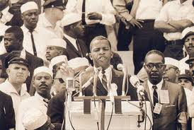
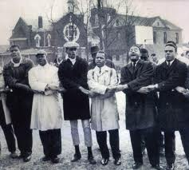
SNNC forced to change speech
We will not stop. If we do not get meaningful legislation out of this Congress, the time will come when we will not confine our marching to Washington. We will march through the South, through the streets of Jackson, through the streets of Danville, through the streets of Cambridge, through the streets of Birmingham. But we will march with the spirit of love and with the spirit of dignity that we have shown here today.
By the force of our demands, our determination and our numbers, we shall splinter the desegregated South into a thousand pieces and put them back together in the image of God and democracy.
We must say, "Wake up, America. Wake up!!! For we cannot stop, and we will not be patient."
(John Lewis was the SNCC Chairman
who ended up in the US Congress)

Slide 12
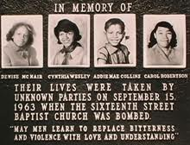
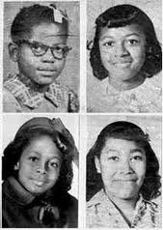
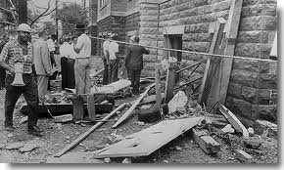
Two weeks after the March on
Washington a bomb exploded
in a church and killed 4 girls.

Slide 13
Chicago
School
Boycotts

Slide 14
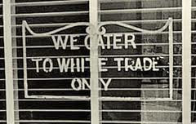
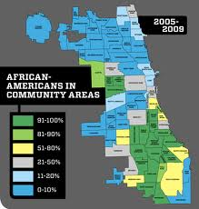
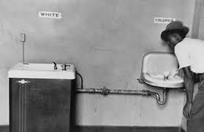
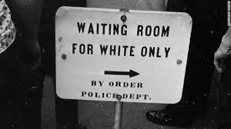
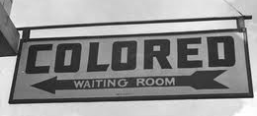
From de jure segregation to de facto segregation

Slide 15


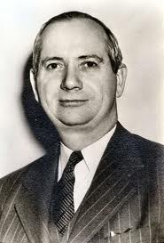
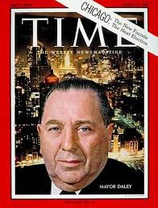
BOYCOTT
De facto segregation was fought in Chicago
against the two leading racist politicians in
the city: Richard Daley (Mayor) and
Benjamin Willis (School Superintendent)

Slide 16
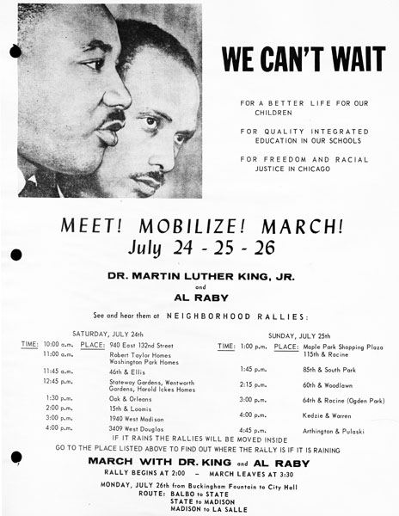

Slide 17
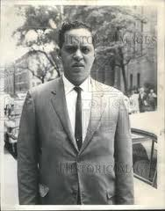
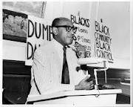
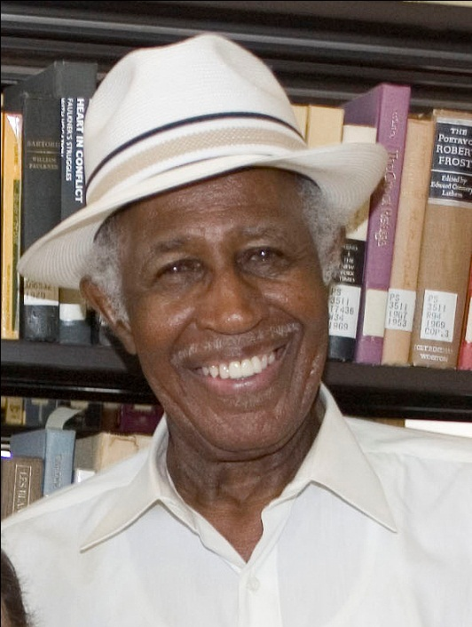
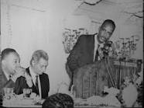
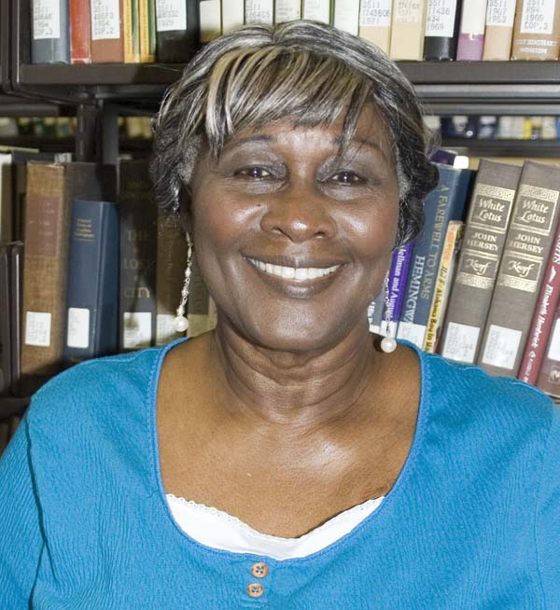

Slide 18
Boycott Rates for Chicago Elementary Schools
School District | Average per cent Black | Absent Oct 22 | Absent Feb 25 | Difference
Black (7 Districts) | 90.7 | 84.3 | 66.1 | 18.2
Integrated (6 Districts) | 59.8 | 50.2 | 37.5 | 12.7
White (8 Districts) | 3.1 | 8.1 | 8.8 | -0.7
Total (12 Districts) | 50.8 | 51.4 | 39.9 | 11.5

Slide 19
Spread of the School Boycott Movement
Date | Place | Size
February 3 | New York City | 464,362 out of 1,037,757
February 11 | Cincinnati, Ohio | 19,000 out of 26,000
February 25 | Chicago, Ill | 172,350 out of
February 25 | Cambridge, Md | Twice the normal absentee rate
February 26 | Boston | 20,500 absent, twice the normal

Slide 20
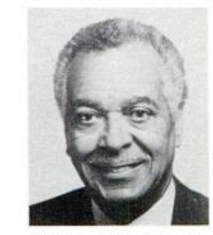
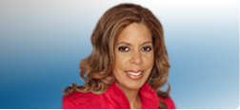
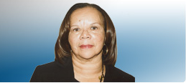
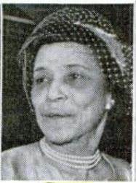
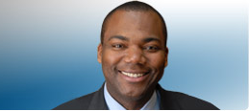
Black members of the Chicago Board of Education
1964
2012
Andrea Zopp
Chicago Urban League
Warren H. Bacon
Inland Steel
Mahalia Hines
Consultant, former principal
Mrs Wendell E. Green
Civic leader
Jean-Claude Brizard
Chief Executive, Chicago Public Schools

Slide 21
Mississippi
Summer project
Freedom
Democratic Party

Slide 22
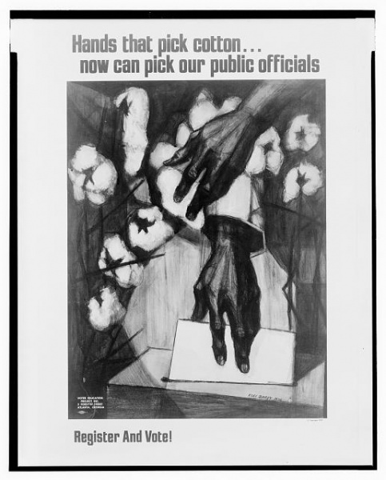






Slide 23







1964 was hot in Mississippi
And new leadership kept coming!

Slide 24






Slide 25



Little brother
was not afraid!

Slide 26






Slide 27



Some Black people got in the box real good. Mass civil
disobedience and legal struggle through legislation and
court decisions was led by a post World War II revolutionary
generation. Many gains were short lived, though, and the
crisis is deeper today. Most of us fought and a few got over.
That’s about it.
We had to do it, and we might have to do it again the way
things are going.

